Slide 1

UNIVERSITY OF PADOVA Physics of Data Astrostatistics and Cosmology
N-Body simulator
Cuda parallelization
-
Gabriele Bertinelli - 2103359
Modern Computing for Physics – 24/25

Slide 2
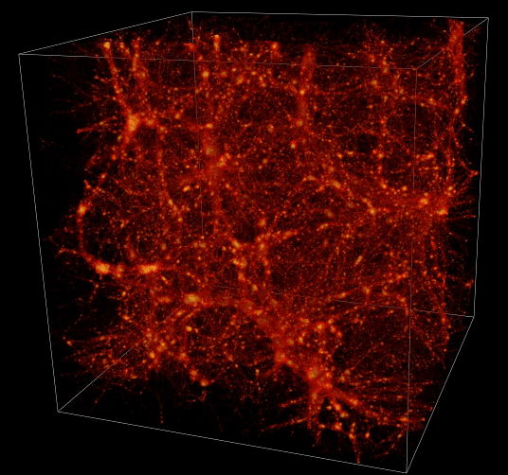
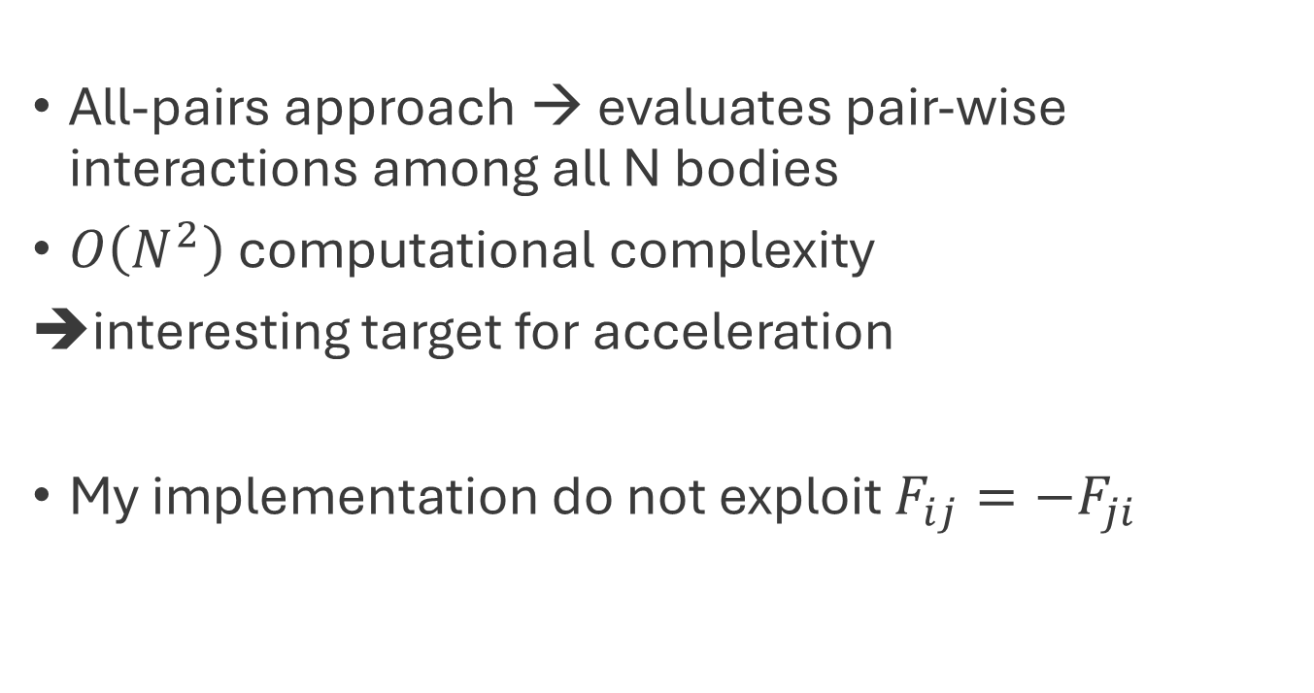
N-body simulator
All-pairs approach → evaluates pair-wise interactions among all N bodies
$O\left(N^{2}\right)$ computational complexity
interesting target for acceleration
My implementation do not exploit $F_{ij}=−F_{ji}$
Credit: W. Hellwig

Slide 3
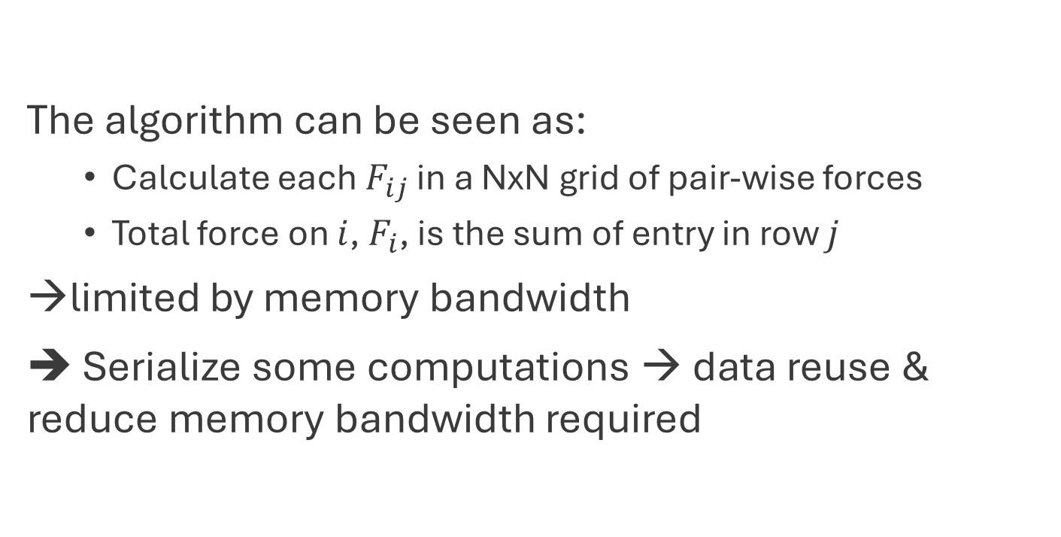
CUDA implementation
The algorithm can be seen as:
Calculate each $F_{ij}$ in a NxN grid of pair-wise forces
Total force on $i$, $F_{i}$, is the sum of entry in row $j$
limited by memory bandwidth
➔ Serialize some computations → data reuse & reduce memory bandwidth required

Slide 4
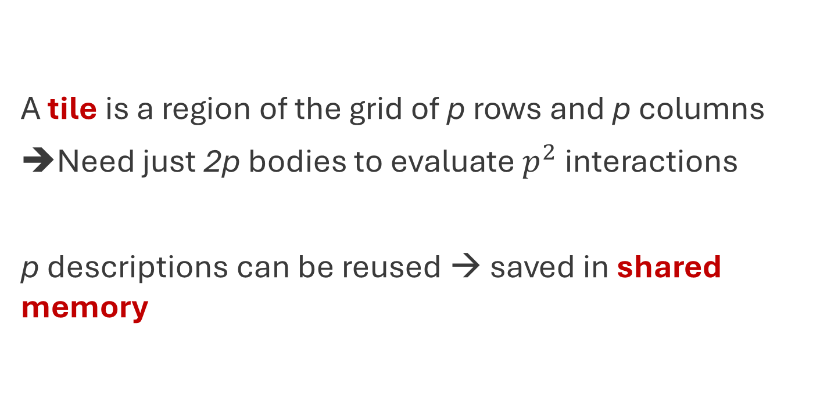
CUDA implementation
A tile is a region of the grid of p rows and p columns
Need just 2p bodies to evaluate $p^{2}$ interactions
p descriptions can be reused → saved in shared memory

Slide 5
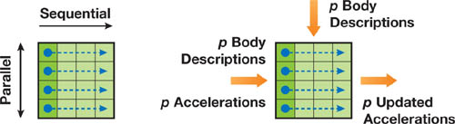
CUDA implementation
Let’s arrange the computation of the tile so that:
each row is evaluated in sequential order → updates acceleration
separate rows are evaluated in parallel
Credit: NVIDIA

Slide 6
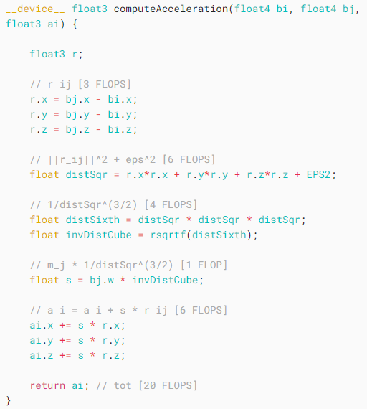
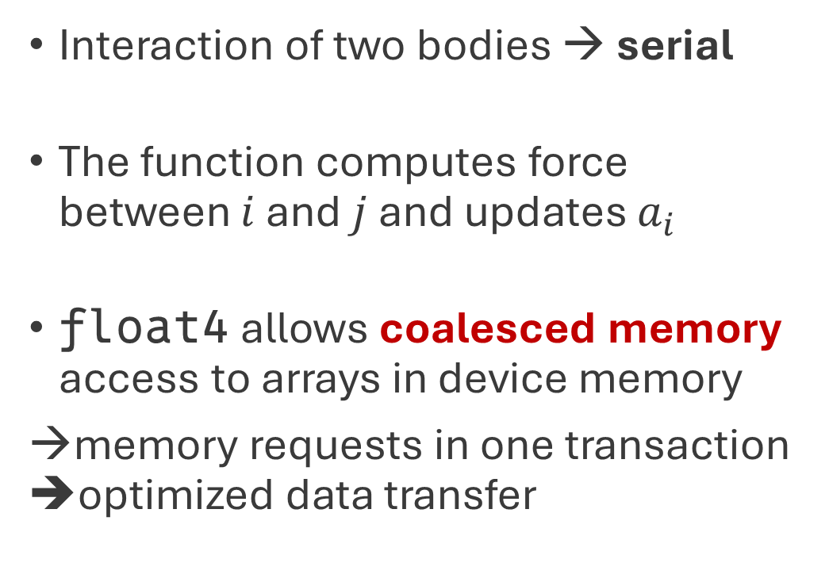
Body-body force calculation
Interaction of two bodies → serial
The function computes force between $i$ and $j$ and updates $a_{i}$
float4 allows coalesced memory access to arrays in device memory
→memory requests in one transaction ➔optimized data transfer
Notes:
When threads in a warp access consecutive elements in global memory, the GPU can combine (or “coalesce”) these individual memory requests into one large transaction. CUDA’s memory system is optimized for transfers in chunks of 16 bytes (or multiples). Using a `float4`—which is exactly 16 bytes—ensures that each body’s data is stored in an aligned, 16‑byte unit.*> *Instead `float3` elements don’t align to the 16‑byte boundaries required for optimal coalescing. This misalignment can force the hardware to perform extra memory transactions or add padding behind the scenes, reducing memory throughput.

Slide 7
Tile calculation
In a tile: each thread updates the acceleration because of its interaction with other p bodies
Credit: NVIDIA

Slide 8
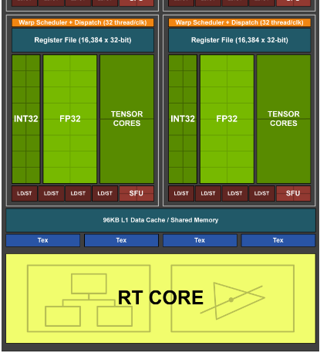
Tile calculation
The code loads p bodies from device mem into shared memory, provided to each thread block
Each thread block evaluates p interactions
The result of the tile is p updated accelerations
Credit: NVIDIA

Slide 9
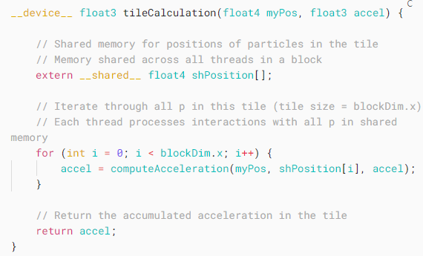
Tile calculation
myPos holds the position of the body in the thread
shPosition is an array of p bodies in shared memory
p threads execute computeAcceleration in parallel

Slide 10
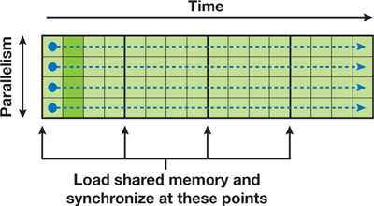
Clustering tiles into thread blocks
Let’s define a thread block as having p threads that executes some number of tiles in sequence
In a thread block there are N/p tiles
A thread block reloads its shared memory every p steps to share p positions of the data
➔ Each thread in a block computes all N Interactions for one body
Credit: NVIDIA
Notes:
The degree of parallelism, i.e. the number of rows, must be sufficiently large so that multiple warps can be interleaved to hide latencies in the evaluation of interactions.
The amount of data reuse grows with the number of columns, and this parameter also governs the size of the transfer from device memory into shared memory.
The size of the tile also determines the shared memory required. The code uses squared tiles pxp. Before executing a tile, each thread fetches one body into **shared memory**, after which the threads synchronize. Then, each tile starts with _p_ successive bodies in the shared memory.

Slide 11
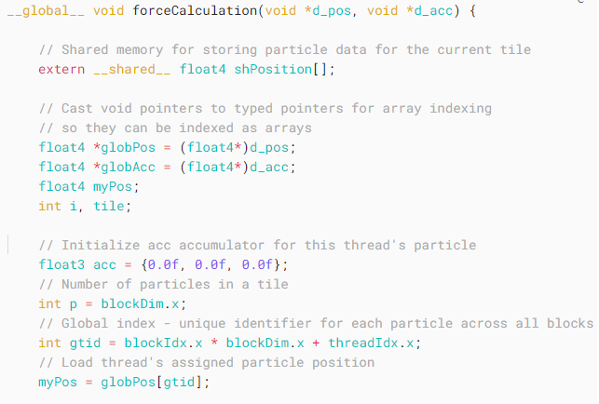
Clustering tiles into thread blocks
This is the code to calculate N-body forces for a thread block

Slide 12
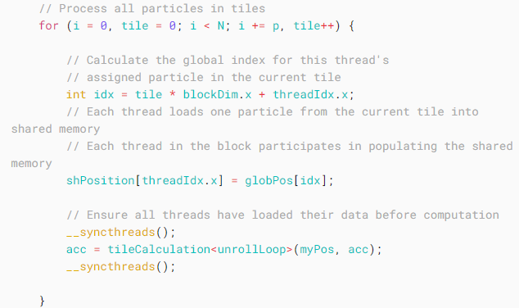
Clustering tiles into thread blocks
This is the code to calculate N-body forces for a thread block
Notes:
The first synchronization ensures that all shared memory locations are populated before the computation proceeds;
The second ensures that all threads finish their computation before advancing to the next tile. *Without the second synchronization, threads that finish their part in the tile calculation might overwrite the shared memory still being read by other threads.*

Slide 13
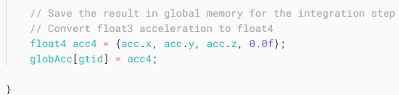
Clustering tiles into thread blocks
This is the code to calculate N-body forces for a thread block

Slide 14
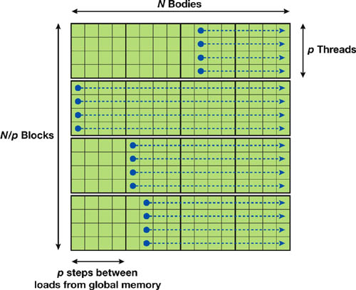
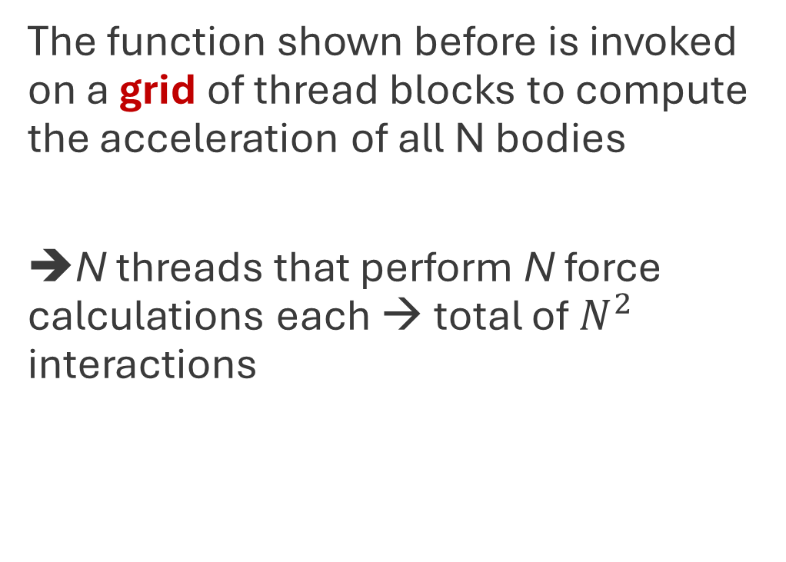
Defining a grid of thread blocks
The function shown before is invoked on a grid of thread blocks to compute the acceleration of all N bodies
➔N threads that perform N force calculations each → total of $N^{2}$ interactions
Credit: NVIDIA

Slide 15
Optimization
There are several possible layers of optimization

Slide 16
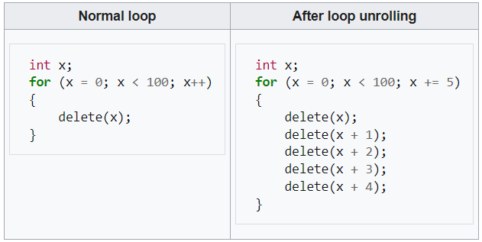
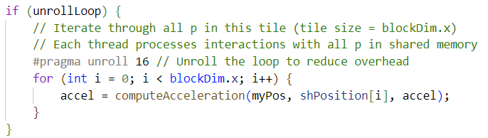
Optimization – Loop unrolling
Replace a single body-body interaction call with 2 to 32 calls to reduce loop overhead In tileCalculation
Credit: Wikipedia
Notes:
On one hand, unrolling the loop can reduce the number of overhead instructions, and potentially reduce the number of clock cycles to process each p-space sample data. On the other hand, too much unrolling can potentially increase the usage of registers and reduce the number of blocks that can fit into a SM.

Slide 17
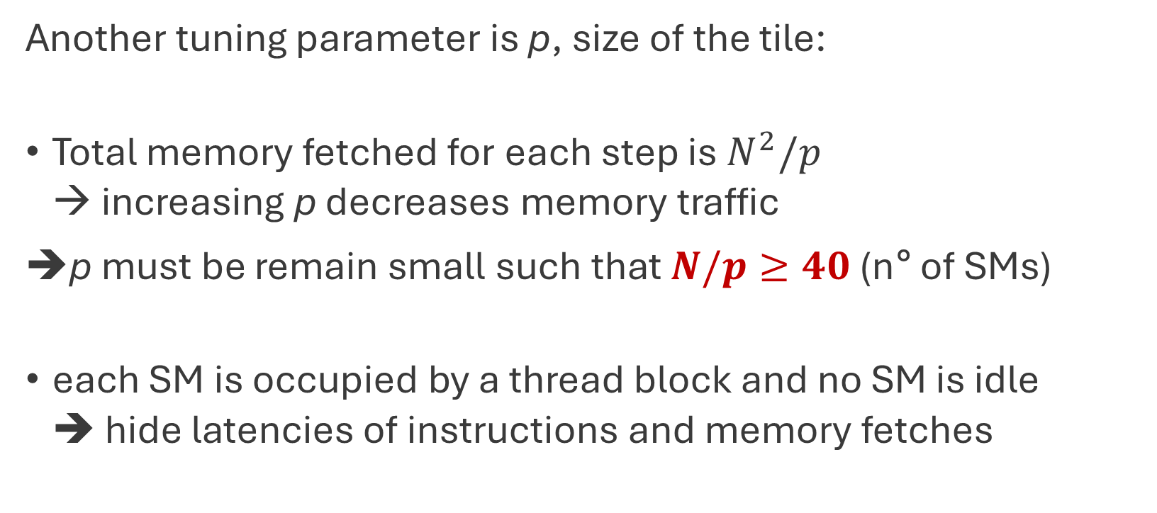
Optimization – Block size
Another tuning parameter is p, size of the tile:
Total memory fetched for each step is $N^{2}/p$ → increasing p decreases memory traffic
p must be remain small such that $N/p≥40$ (n°of SMs)
each SM is occupied by a thread block and no SM is idle ➔ hide latencies of instructions and memory fetches

Slide 18
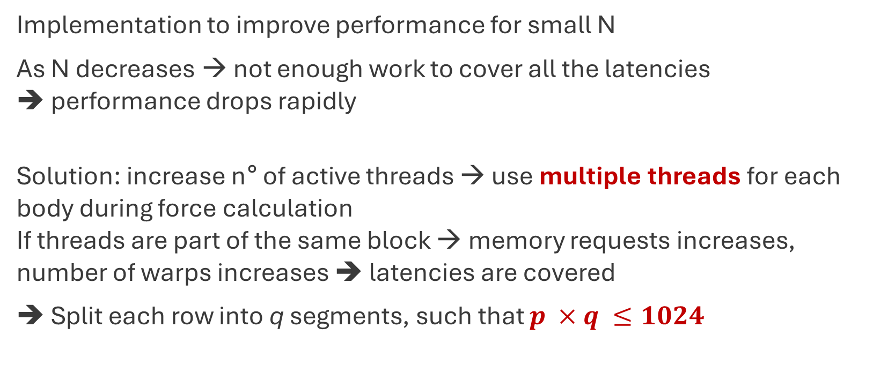
Optimization – Multi-threads per body (not implemented)
Implementation to improve performance for small N
As N decreases → not enough work to cover all the latencies ➔ performance drops rapidly
Solution: increase n°of active threads → use multiple threads for each body during force calculation If threads are part of the same block → memory requests increases, number of warps increases ➔ latencies are covered
➔ Split each row into q segments, such that $p ×q ≤1024$
Notes:
(Tesla T4 allows for max 1024 threads per block)

Slide 19
Optimization – High-level directives (not implemented)
Nowadays there exist many high-level compiler directives → expose parallelism in the code and parallelize compilers to build the code
One example is OpenACC → other than parallelization, it supports offloading of both computation and data from host to/from device
OpenACC compiler and runtime analyze the code and handle parallelization, memory management and data transfer
Certain optimization are too low-level ➔ as usual, it depends

Slide 20
Performance analysis
Tesla T4 GPU is equipped with 2560 processors @ 1.59 GHz → counting 1 FLOP/cycle/processor ➔ 4070.5 GFLOPS
To compare GFLOPS rate → count the FLOPS in the high-level code computeAcceleration ➔ 20 FLOPS per pair-wise calculation (inverse square root takes 16 clock cycles → I assigned anyway 1 FLOP)
All tests were made by integrating 1000 steps
Notes:
tests barely reach the peak aforementioned, probably either due to sub-optimal implementation and low number of bodies that did not “squeeze” the potential of the GPU.

Slide 21
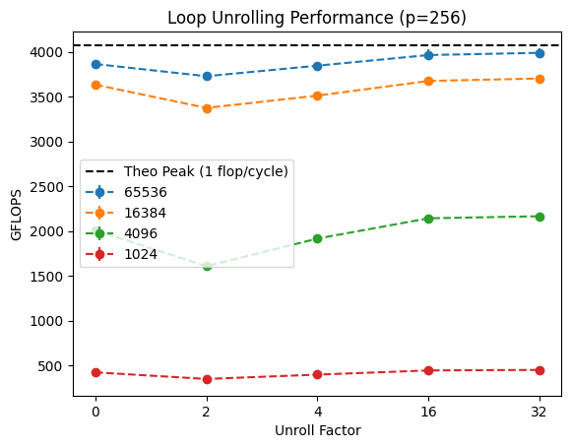
Performance analysis – Loop unrolling
Unroll=0,16 reach similar performances → modern compilers automatically unroll loops when beneficial
With N=65536 → almost theoretical peak (using a bigger N, the code probably would have reached the peak)
➔ Set unroll factor to 16
Notes:
The difference between unroll=16 and unroll=32 is $\sim 1\%$ for all number of bodies. The benchmark was run 10 times for each data point. The errors are comparable or smaller than the marker.

Slide 22
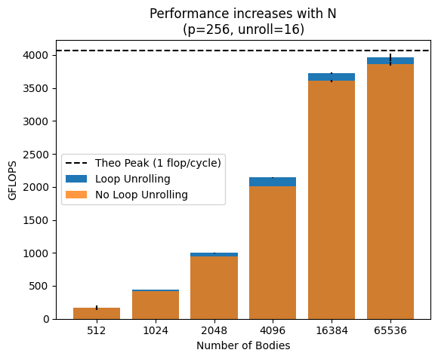
Performance analysis – Number of bodies
Performance increases with N
More bodies → more threads → increase occupancy ➔ hide memory latency and delays
Fixed overheads are spread out on more computations ➔ overall efficiency
When workload is small → execution time is spent more on overhead than computation ➔ less efficient
Notes:
Fixed overheads (like kernel launch and memory access initialization)

Slide 23
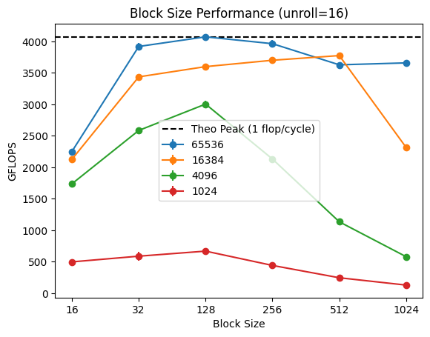
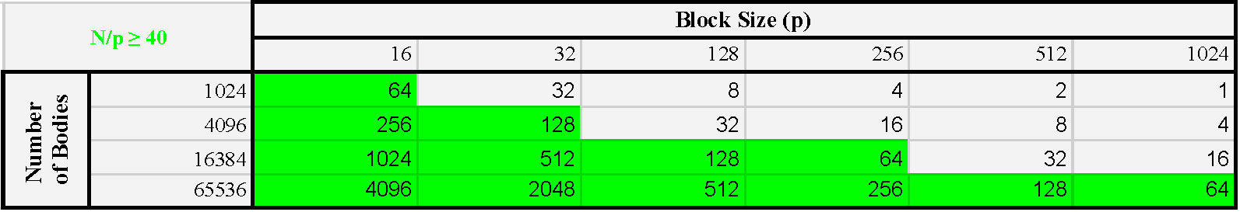
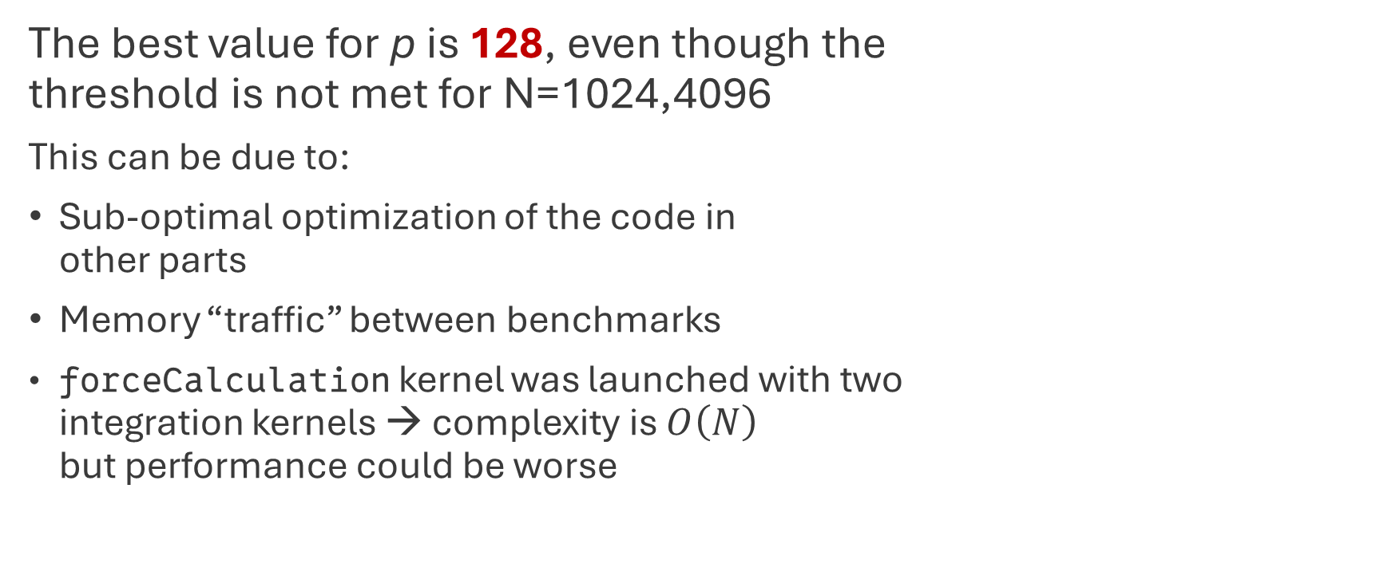
Performance analysis – Block size
The best value for p is 128, even though the threshold is not met for N=1024,4096
This can be due to:
Sub-optimal optimization of the code in other parts
Memory “traffic” between benchmarks
forceCalculation kernel was launched with two integration kernels → complexity is $O\left(N\right)$ but performance could be worse
Notes:
memory cleaning, host and device wise, is performed and before any benchmark the GPU is primed to remove any one-time initialization overhead.

Slide 24
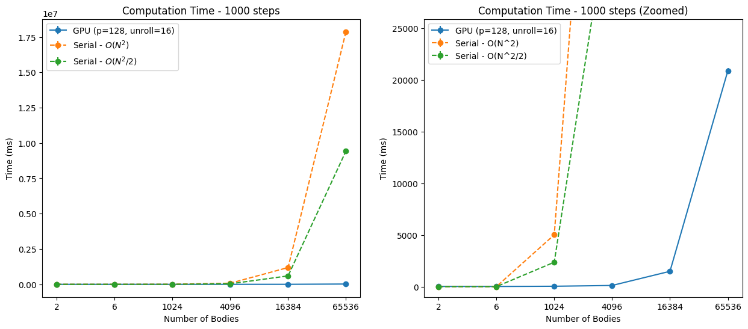
Performance analysis – Computational time
Notes:
The plot on the right is a zoom-in of the plot on the left, for showing better the GPU time. The benchmark on serial code for N=16384, 65536 was run just 1 time, instead of 10, because it took too much time. The errors are comparable or smaller than the marker.

Slide 25
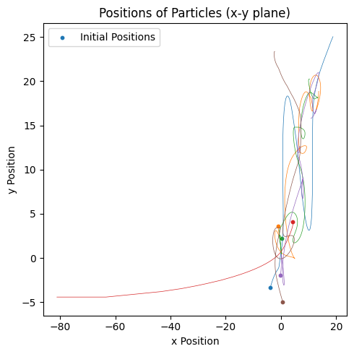
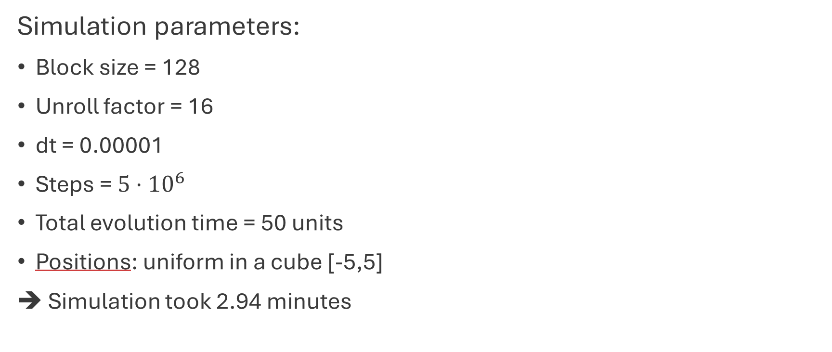
Six bodies system evolution
Simulation parameters:
Block size = 128
Unroll factor = 16
dt = 0.00001
Steps = $5⋅{10}^{6}$
Total evolution time = 50 units
Positions: uniform in a cube [-5,5]
➔ Simulation took 2.94 minutes
Notes:
the bodies were sampled to far away from each other, requiring a smaller integration steps and much much longer integration times. In fact, when particles are far from each other a faster method based on a far-field approximation is used. If one increases the number of bodies to 20 or even more, the cube of size L works just fine.

Slide 26
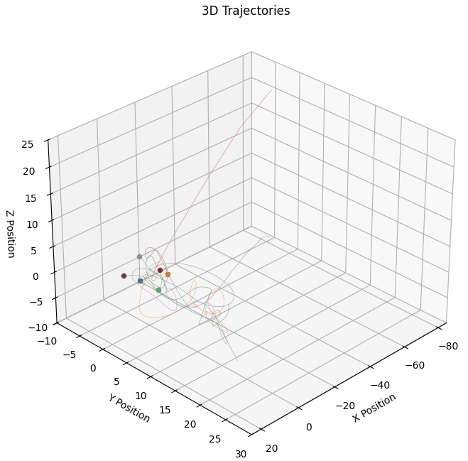
Six bodies system evolution
Notes:
the bodies were sampled to far away from each other, requiring a smaller integration steps and much much longer integration times. In fact, when particles are far from each other a faster method based on a far-field approximation is used. If one increases the number of bodies to 20 or even more, the cube of size L works just fine.

Slide 27
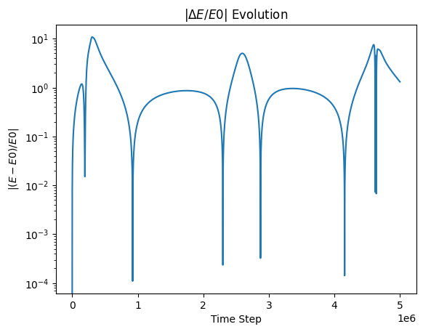

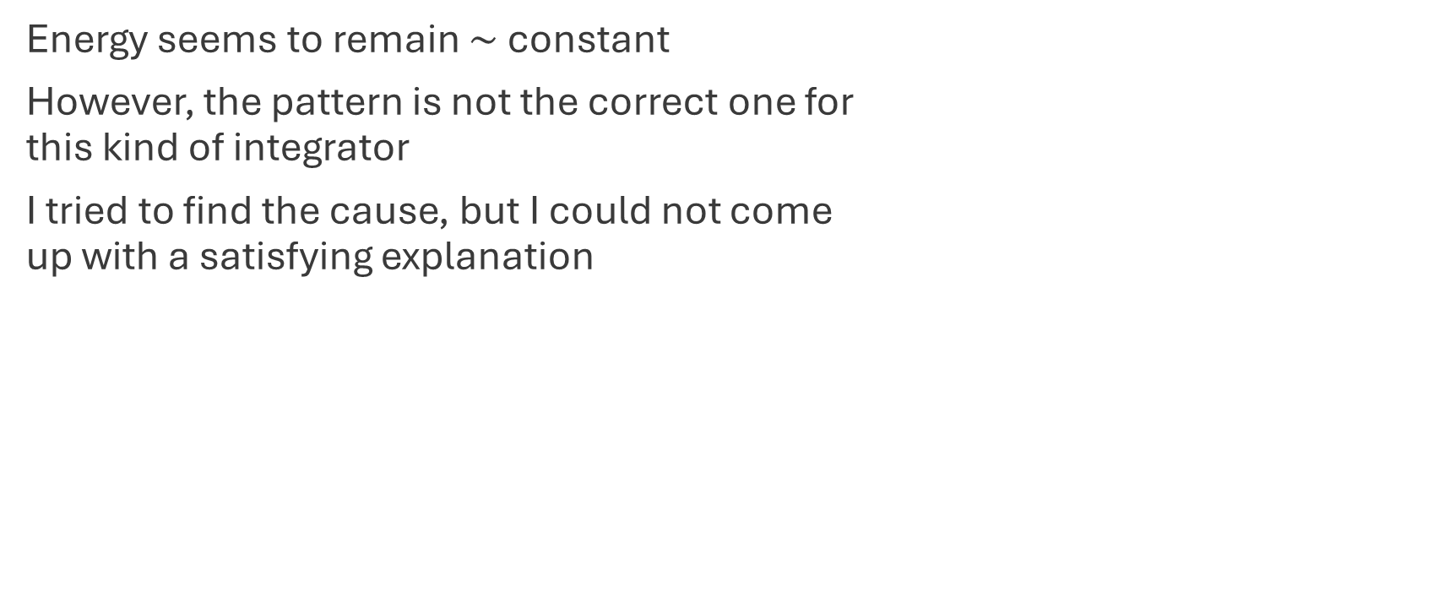
Six bodies system evolution
Energy seems to remain $∼$ constant
However, the pattern is not the correct one for this kind of integrator
I tried to find the cause, but I could not come up with a satisfying explanation
Notes:
I tried to find the cause but the functions are the same to the one I've written for a Python N-body simulator called [Fireworks](https://gitlab.com/i-miloncini/pod_compastro23/-/tree/main/Fireworks). My guess is that this discrepancy is due to a different handling of the data in memory and rounding. The integrator works just fine, because I've tested it with a 2-body system and the Lagrange problem of three masses in an equatorial triangle. Even though the integrator worked, I had to check many different integration time steps and softening factors because the values used in Firework, with this implementation (and also in the serial code, that is basically the same as the GPU code), didn't work out. I also tried to translate the Python code in C language using the Verlet integrator and the values used with Fireworks the simulation and the energy error were fine

Slide 28

THANK YOU FOR YOUR ATTENTION!
UNIVERSITY OF PADOVA Physics of Data Astrostatistics and Cosmology

